Slide 1
W4111 – Introduction to Databases Section 002, Fall 2023 Lecture 10: Module II, NoSQL, Part
© Donald F. Ferguson, 2023

Slide 2

Indexes
2 | COMS W4111_002_2023_3: Lecture_10_Module_II_NoSQL_3 © Donald F. Ferguson, 2023

Slide 3

Indexes
3 | COMS W4111_002_2023_1 - Lecture 9: Module II, NoSQL, Graph DBs © Donald F. Ferguson, 2023

Slide 4

DBMS
Today
Find things quickly.
Database Systems: The Complete Book (2nd Edition) by Hector Garcia-Molina (Author), Jeffrey D. Ullman (Author), Jennifer Widom (Author)

Slide 5
Basic Concepts
Indexing mechanisms used to speed up access to desired data.
E.g., author catalog in library
Search Key - attribute to set of attributes used to look up records in a file.
An index file consists of records (called index entries) of the form
Index files are typically much smaller than the original file
Two basic kinds of indices:
Ordered indices: search keys are stored in sorted order
Hash indices: search keys are distributed uniformly across “buckets” using a “hash function”.
search-key
pointer

Slide 6
Ordered Indices
In an ordered index, index entries are stored sorted on the search key value.
Clustering index: in a sequentially ordered file, the index whose search key specifies the sequential order of the file.
Also called primary index
The search key of a primary index is usually but not necessarily the primary key.
Secondary index: an index whose search key specifies an order different from the sequential order of the file. Also called nonclustering index.
Index-sequential file: sequential file ordered on a search key, with a clustering index on the search key.

Slide 7
Dense Index Files
Dense index — Index record appears for every search-key value in the file.
E.g. index on ID attribute of instructor relation

Slide 8
Dense Index Files (Cont.)
Dense index on dept_name, with instructor file sorted on dept_name

Slide 9
Sparse Index Files
Sparse Index: contains index records for only some search-key values.
Applicable when records are sequentially ordered on search-key
To locate a record with search-key value K we:
Find index record with largest search-key value < K
Search file sequentially starting at the record to which the index record points

Slide 10
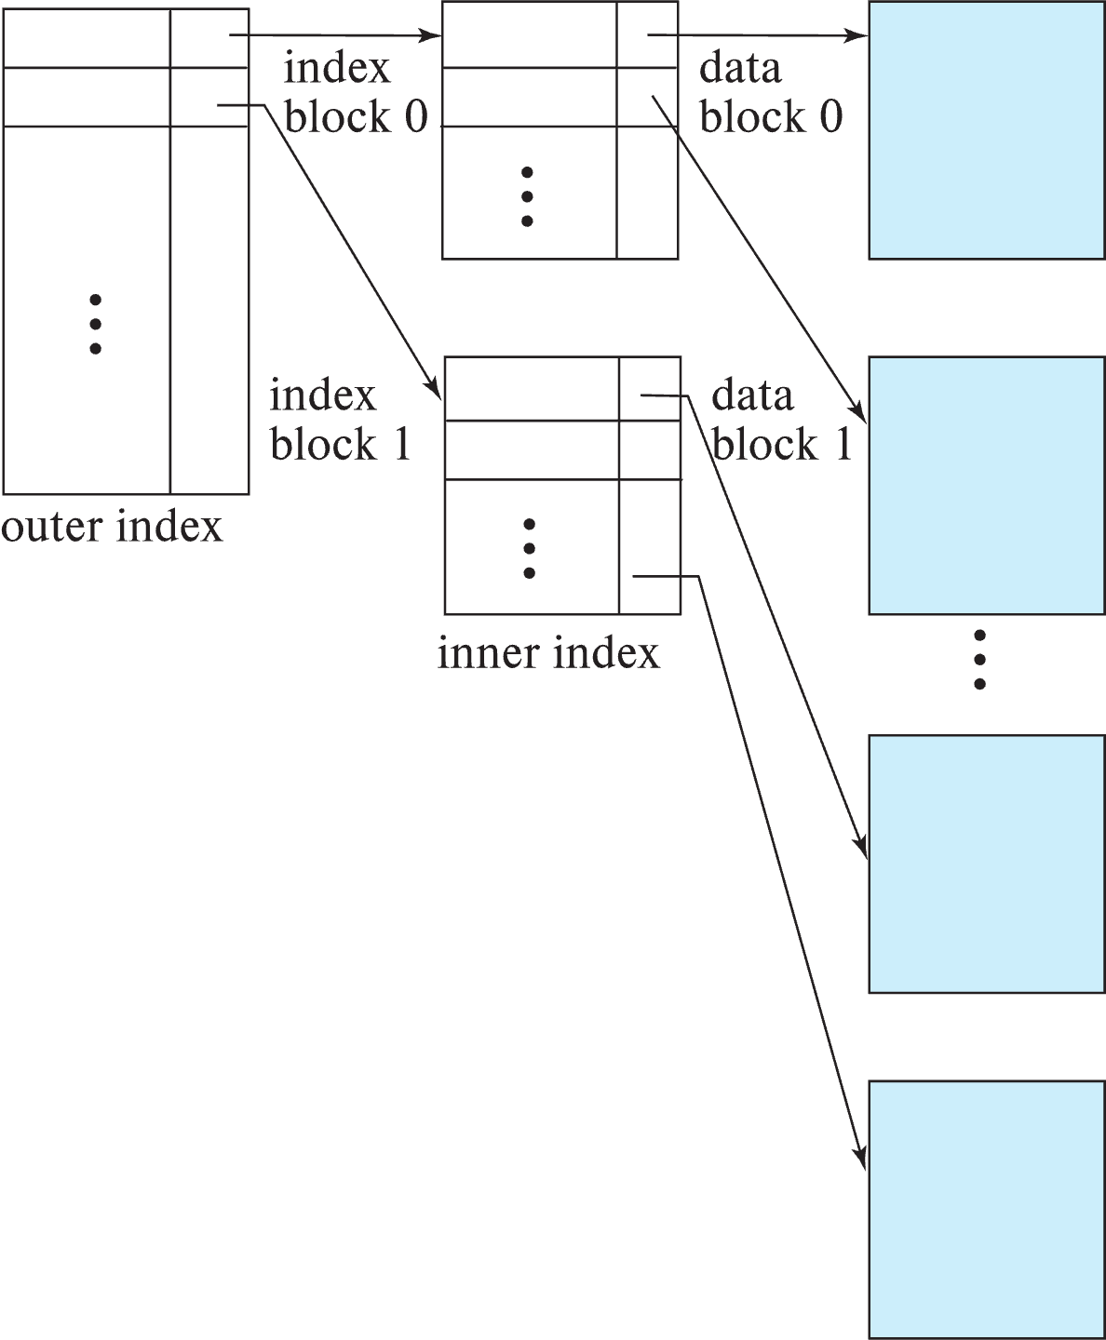
Sparse Index Files (Cont.)
Compared to dense indices:
Less space and less maintenance overhead for insertions and deletions.
Generally slower than dense index for locating records.
Good tradeoff:
for clustered index: sparse index with an index entry for every block in file, corresponding to least search-key value in the block.
For unclustered index: sparse index on top of dense index (multilevel index)

Slide 11
Secondary Indices Example
Secondary index on salary field of instructor
Index record points to a bucket that contains pointers to all the actual records with that particular search-key value.
Secondary indices have to be dense

Slide 12
Clustering vs Nonclustering Indices
Indices offer substantial benefits when searching for records.
BUT: indices imposes overhead on database modification
when a record is inserted or deleted, every index on the relation must be updated
When a record is updated, any index on an updated attribute must be updated
Sequential scan using clustering index is efficient, but a sequential scan using a secondary (nonclustering) index is expensive on magnetic disk
Each record access may fetch a new block from disk
Each block fetch on magnetic disk requires about 5 to 10 milliseconds

Slide 13
Indices on Multiple Keys
Composite search key
E.g., index on instructor relation on attributes (name, ID)
Values are sorted lexicographically
E.g. (John, 12121) < (John, 13514) and (John, 13514) < (Peter, 11223)
Can query on just name, or on (name, ID)
(nameLast, nameFirst, birthyear)
nameLast [nameLast = “Ferguson”] [nameLast like “Fer%”]
nameLast, nameFirst
nameLast, nameFirst, birthyear
NOT and index on
nameFirst, nameLast
birthyear
nameLast like [%er%]

Slide 14
B⁺-Tree Index Files
Disadvantage of indexed-sequential files
Performance degrades as file grows, since many overflow blocks get created.
Periodic reorganization of entire file is required.
Advantage of B⁺-tree index files:
Automatically reorganizes itself with small, local, changes, in the face of insertions and deletions.
Reorganization of entire file is not required to maintain performance.
(Minor) disadvantage of B⁺-trees:
Extra insertion and deletion overhead, space overhead.
Advantages of B⁺-trees outweigh disadvantages
B⁺-trees are used extensively

Slide 15
Example of B⁺-Tree

Slide 16
B⁺-Tree Index Files (Cont.)
A B⁺-tree is a rooted tree satisfying the following properties:
All paths from root to leaf are of the same length
Each node that is not a root or a leaf has between ⎡n/2⎤ and n children.
A leaf node has between ⎡(n–1)/2⎤ and n–1 values
Special cases:
If the root is not a leaf, it has at least 2 children.
If the root is a leaf (that is, there are no other nodes in the tree), it can have between 0 and (n–1) values.

Slide 17
B⁺-Tree Node Structure
Typical node
K_{i} are the search-key values
P_{i} are pointers to children (for non-leaf nodes) or pointers to records or buckets of records (for leaf nodes).
The search-keys in a node are ordered
K₁ < K₂ < K₃ < . . . < K_{n–1}
(Initially assume no duplicate keys, address duplicates later)

Slide 18
Leaf Nodes in B⁺-Trees
Properties of a leaf node:
For i = 1, 2, . . ., n–1, pointer P_{i} points to a file record with search-key value K_{i},
If L_{i}, L_{j} are leaf nodes and i < j, L_{i}’s search-key values are less than or equal to L_{j}’s search-key values
P_{n} points to next leaf node in search-key order

Slide 19
Non-Leaf Nodes in B⁺-Trees
Non leaf nodes form a multi-level sparse index on the leaf nodes. For a non-leaf node with m pointers:
All the search-keys in the subtree to which P₁ points are less than K₁
For 2 ≤ i ≤ n – 1, all the search-keys in the subtree to which P_{i} points have values greater than or equal to K_{i–1} and less than K_{i}
All the search-keys in the subtree to which P_{n} points have values greater than or equal to K_{n–1}
General structure

Slide 20
Example of B⁺-tree
B⁺-tree for instructor file (n = 6)
Leaf nodes must have between 3 and 5 values (⎡(n–1)/2⎤ and n –1, with n = 6).
Non-leaf nodes other than root must have between 3 and 6 children (⎡(n/2⎤ and n with n =6).
Root must have at least 2 children.

Slide 21
Observations about B⁺-trees
Since the inter-node connections are done by pointers, “logically” close blocks need not be “physically” close.
The non-leaf levels of the B⁺-tree form a hierarchy of sparse indices.
The B⁺-tree contains a relatively small number of levels
Level below root has at least 2* ⎡n/2⎤ values
Next level has at least 2* ⎡n/2⎤ * ⎡n/2⎤ values
.. etc.
If there are K search-key values in the file, the tree height is no more than ⎡ log_{⎡n/2⎤}(K)⎤
thus searches can be conducted efficiently.
Insertions and deletions to the main file can be handled efficiently, as the index can be restructured in logarithmic time (as we shall see).

Slide 22
Show the Simulator
https://www.cs.usfca.edu/~galles/visualization/BPlusTree.html

Slide 23
Hashing

Slide 24
Static Hashing
A bucket is a unit of storage containing one or more entries (a bucket is typically a disk block).
we obtain the bucket of an entry from its search-key value using a hash function
Hash function h is a function from the set of all search-key values K to the set of all bucket addresses B.
Hash function is used to locate entries for access, insertion as well as deletion.
Entries with different search-key values may be mapped to the same bucket; thus entire bucket has to be searched sequentially to locate an entry.
In a hash index, buckets store entries with pointers to records
In a hash file-organization buckets store records

Slide 25
Handling of Bucket Overflows (Cont.)
Overflow chaining – the overflow buckets of a given bucket are chained together in a linked list.
Above scheme is called closed addressing (also called closed hashing or open hashing depending on the book you use)
An alternative, called open addressing (also called open hashing or closed hashing depending on the book you use) which does not use over- flow buckets, is not suitable for database applications.

Slide 26
Example of Hash File Organization
Hash file organization of instructor file, using dept_name as key.

Slide 27
Deficiencies of Static Hashing
In static hashing, function h maps search-key values to a fixed set of B of bucket addresses. Databases grow or shrink with time.
If initial number of buckets is too small, and file grows, performance will degrade due to too much overflows.
If space is allocated for anticipated growth, a significant amount of space will be wasted initially (and buckets will be underfull).
If database shrinks, again space will be wasted.
One solution: periodic re-organization of the file with a new hash function
Expensive, disrupts normal operations
Better solution: allow the number of buckets to be modified dynamically.

Slide 28
Show the Simulator
http://iswsa.acm.org/mphf/openDSAPerfectHashAnimation/perfectHashAV.html
https://opendsa-server.cs.vt.edu/ODSA/AV/Development/hashAV.html

Slide 29
NoSQL GraphDB
29 | COMS W4111_002_2023_3: Lecture 10: Module II, NoSQL 3 © Donald F. Ferguson, 2023

Slide 30
Simplistic Classification (https://medium.com/swlh/4-types-of-nosql-databases-d88ad21f7d3b)
Relational is the foundational model.
We will see OLAP in a future lecture.
Subject of this lecture and part of HW4
We covered graphs and examples.

Slide 31
Graph Database
Exactly what it sounds like
Two core types
Node
Edge (link)
Nodes and Edges have
Label(s) = “Kind”
Properties (free form)
Query is of the form
p1(n)-p2(e)-p3(m)
n, m are nodes; e is an edge
p1, p2, p3 are predicates on labels
N->R->M

Slide 32
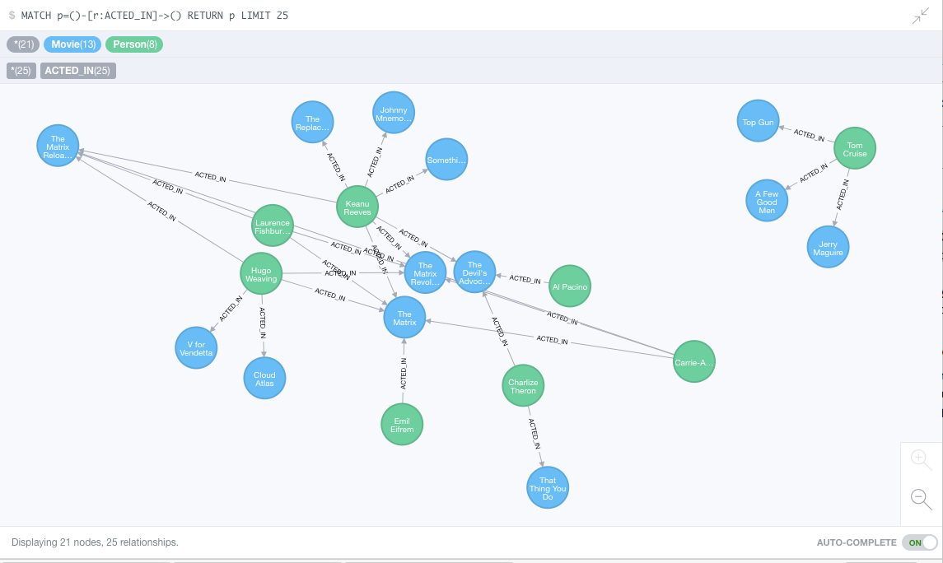
Neo4J Graph Query

Slide 33
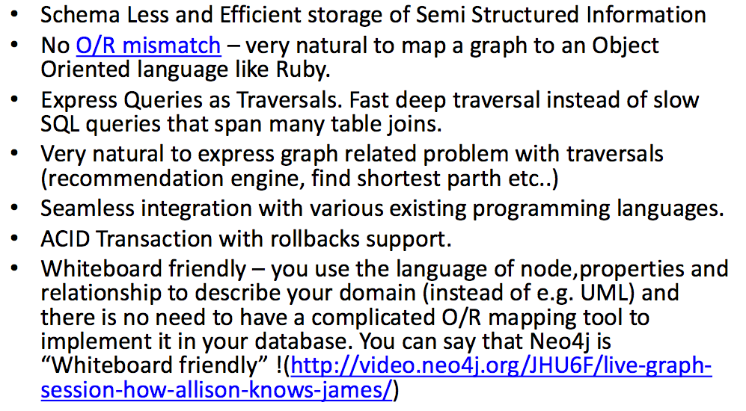
Why Graph Databases?

Slide 34
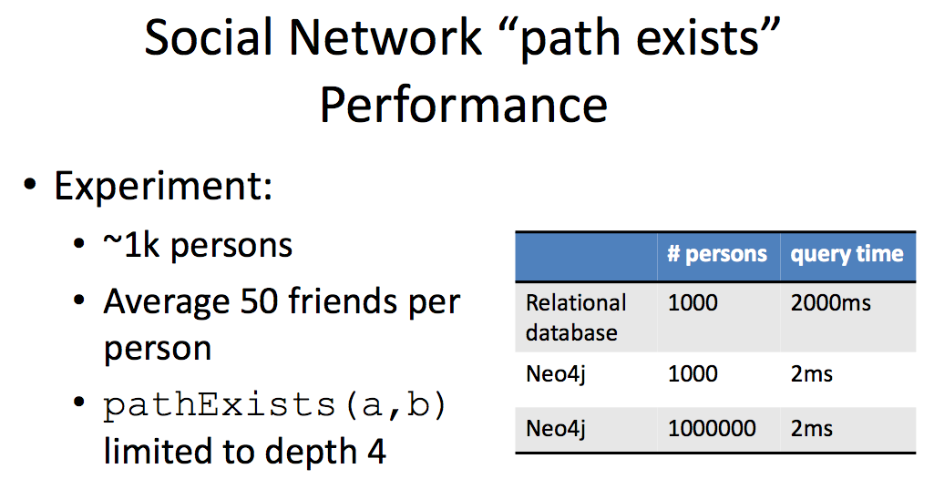
Graph databases are
Extremely fast for some queries and data models.
Implement a language that vastly simplifies writing queries.

Slide 35
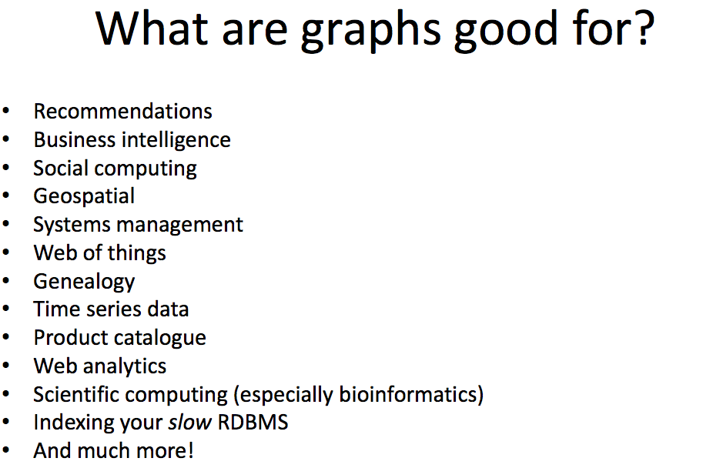

Slide 36
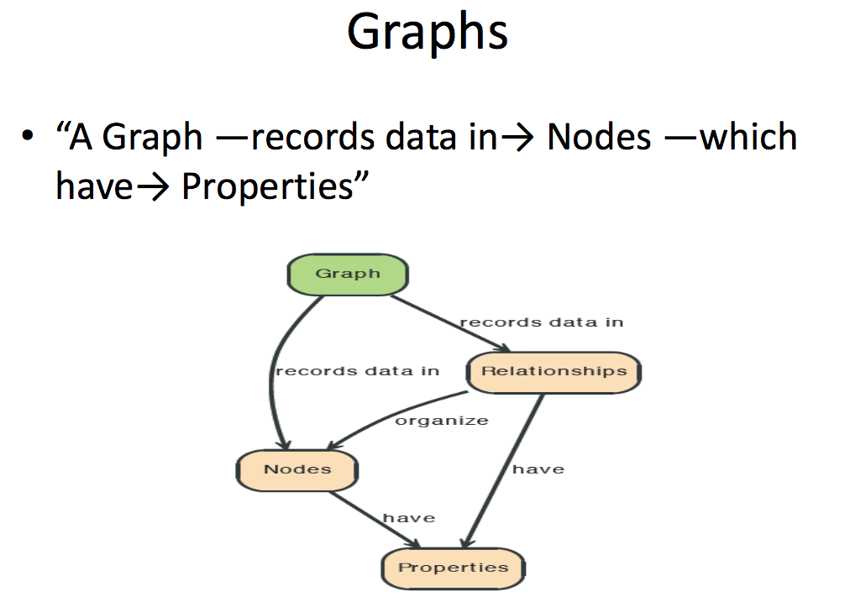

Slide 37
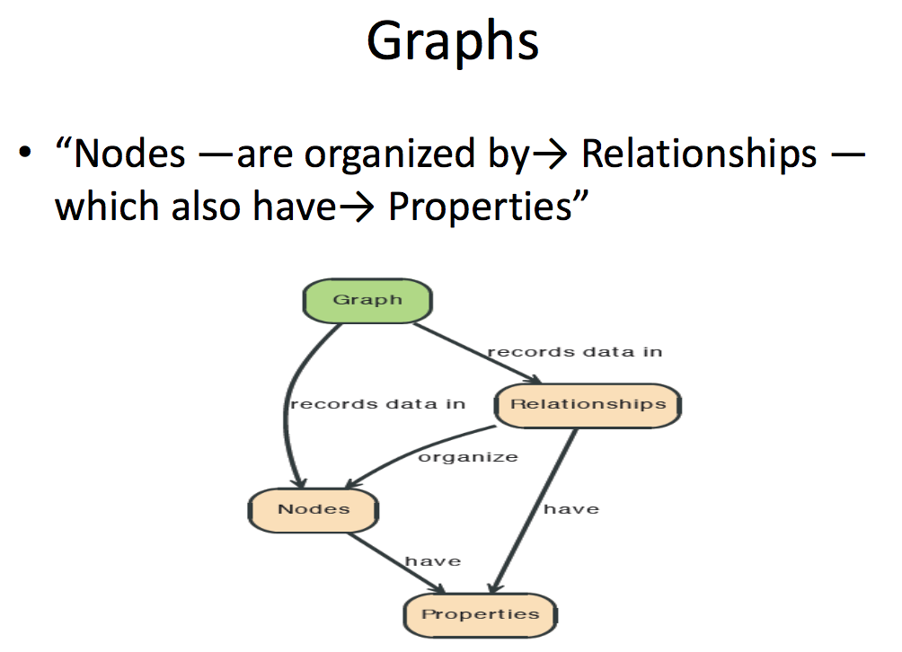

Slide 38
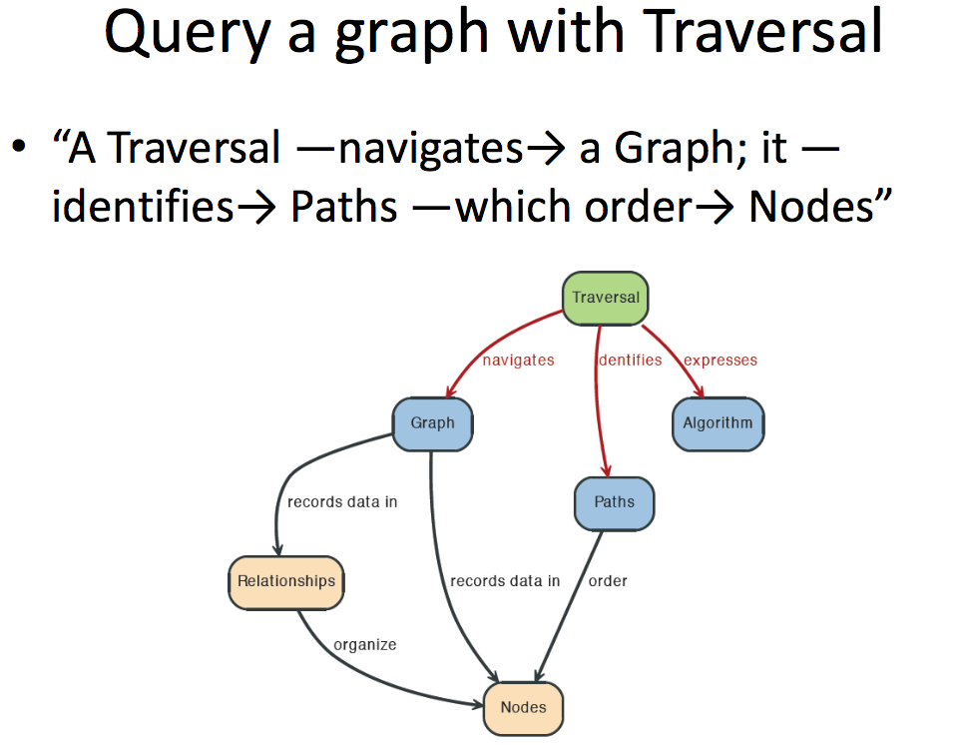

Slide 39
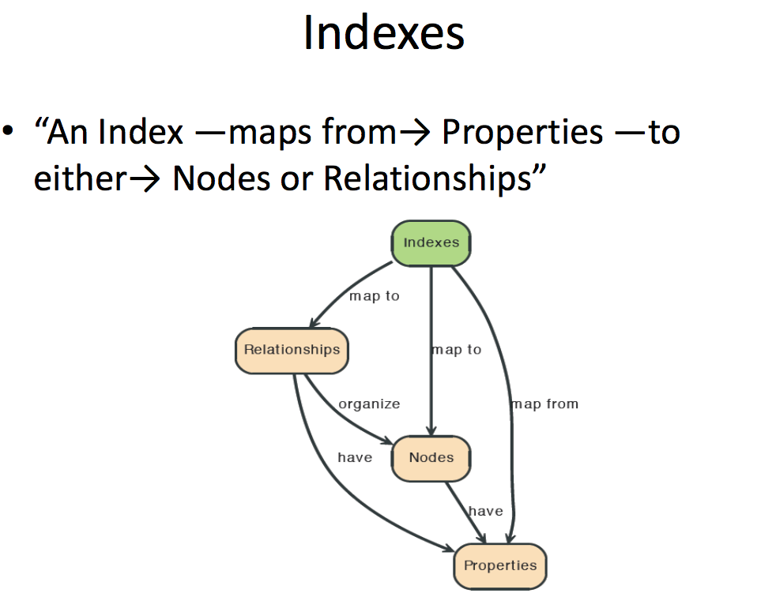

Slide 40
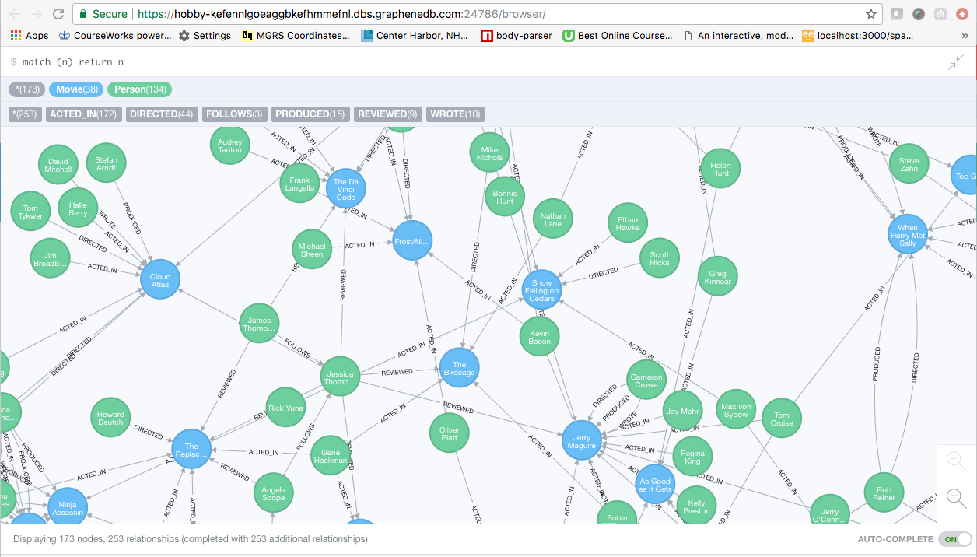
A Graph Database (Sample)

Slide 41
Neo4J Graph Query
Who acted in which movies?

Slide 42
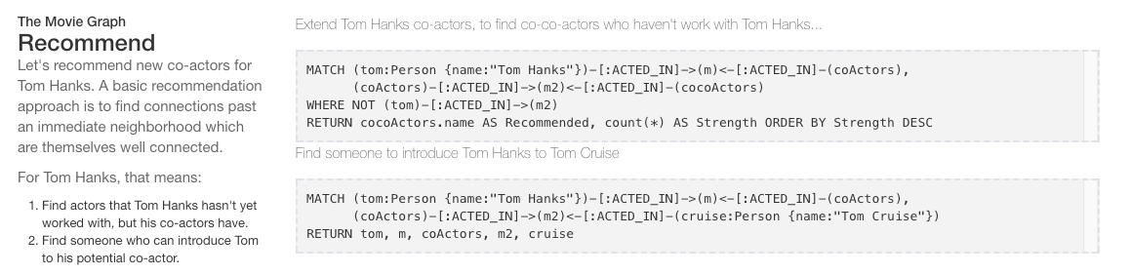
Big Deal. That is just a JOIN.
Yup. But that is simple.
Try writing the queries below in SQL.

Slide 43
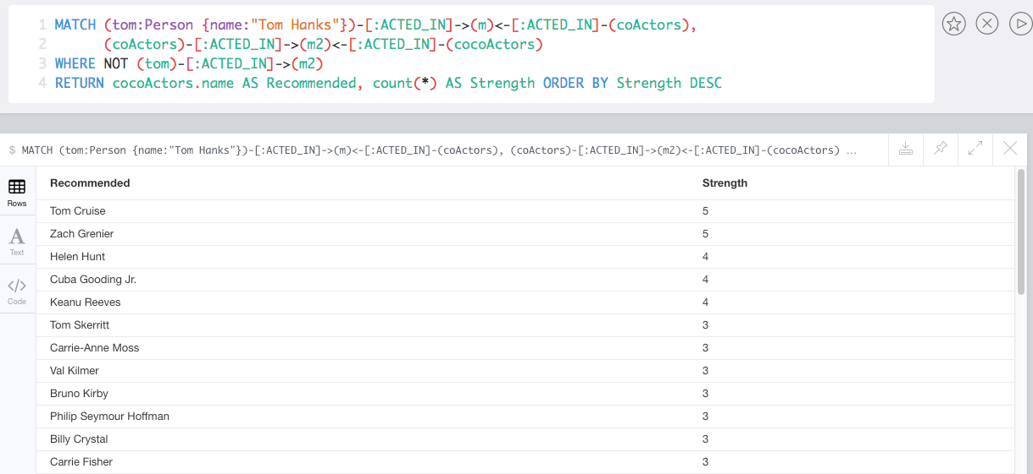
Recommend

Slide 44
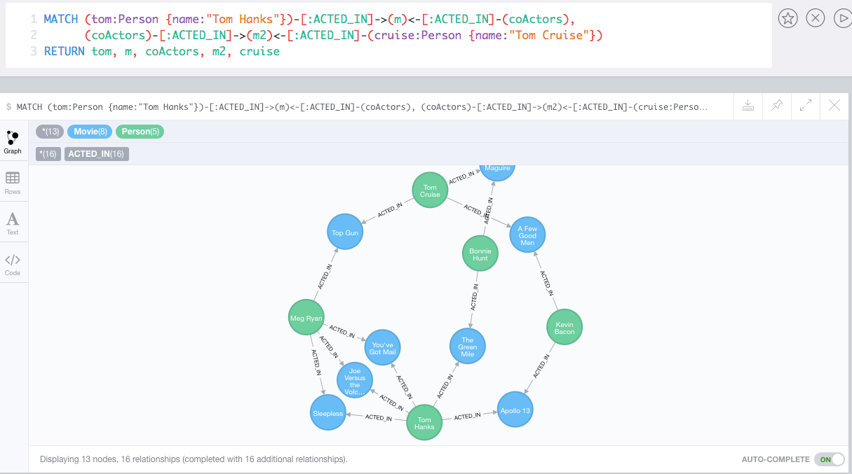
Which actors have worked with both Tom Hanks and
Tom Cruise?

Slide 45
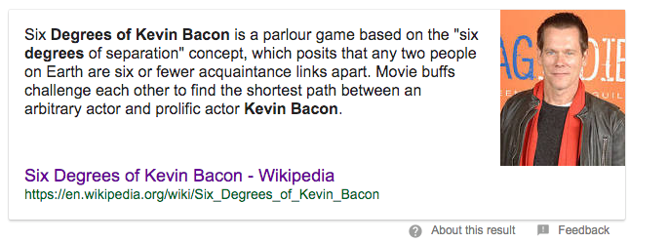
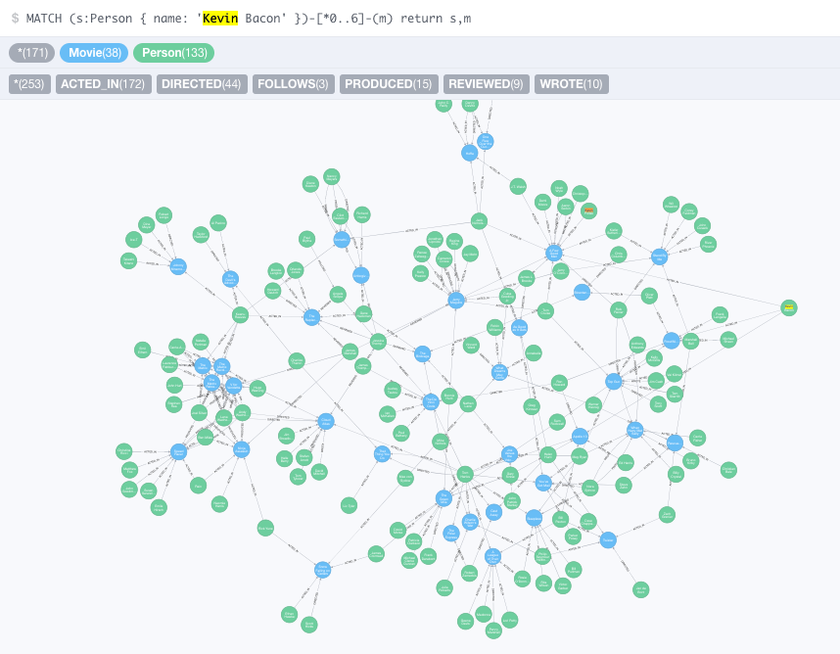
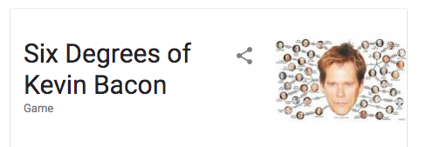

Slide 46
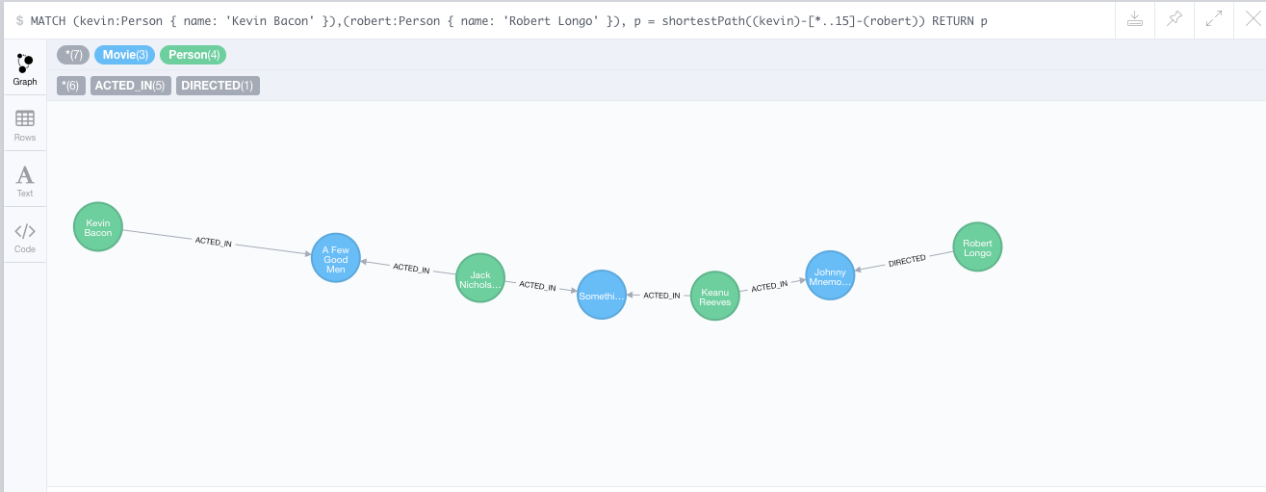
How do you get from Kevin Bacon to
Robert Longo?

Slide 47
Watch Professor Ferguson Write Neo4j and MongoDB
47 | COMS W4111_002_2023_3: Lecture 10: Module II, NoSQL 3 © Donald F. Ferguson, 2023

